Slide 1
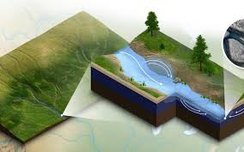
Predicting the quality of water using ML algorithm

Slide 2
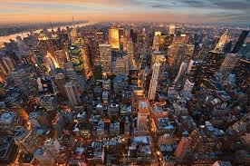
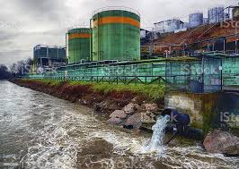
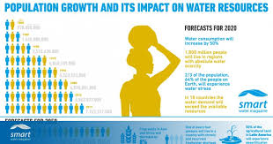
Abstract
Issue of poor water quality due to urbanisation, industrial waste, population expansion.
Frequently, the pollution is the result of our own acts.
It is urgent that this issue be resolved so that good water may be obtained for diverse uses.
Building a machine learning model for analysing the water quality of Indian rivers is the main goal of our effort.
Urbanization
Industrial waste

Slide 3

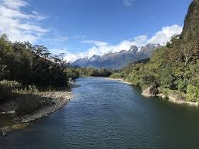
Introduction
Humanity benefits much from the lakes, rivers, marshes, and other sources of water.
Nearly 1.6 million people die each year as a result of waterborne infections, according to a UNO report [1].
Poor water quality causes about 1.8 million deaths annually in poorer countries [2].
Therefore, a variety of methodologies are required to evaluate the water's quality and identify its likely future trends in order to minimise any negative effects on humanity as a whole.

Slide 4

Introduction
Motivation:
During the last years, water quality has been threatened by various pollutants. Therefore modeling and predicting water quality have become very important in controlling water pollution.

Slide 5

Introduction
Objective:
To predict the water quality and to using two different models in terms of minimizing the difference between predicted and actual rating.

Slide 6
Related work
In [3], the researchers suggested combining the particle swarm optimization (PSO) method with least squares SVM to predict the quality.
An ANN-NAR, a time-series analysis, and an artificial feedforward neural network were used to create a model in [5] that could predict the quality of water.
In [4], they predicted a free-built wetland's water quality index. With a Mean Absolute Error (MAE) of 0.9984

Slide 7
Methodology
Dataset
Steps involved
PH
Hardness
Solids
Chloramines
Sulphate
Conductivity
Organic carbon
Trihalomethanes
Turbidity
Probability
Data Collection
Data Pre-processing
Data visualization
Training model
Testing model

Slide 8
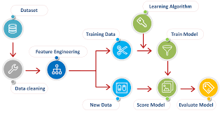
Methodology
Algorithms Used:
Logistic Regression
Decision Tree Classifier
Support Vector Machine
Random forest

Slide 9
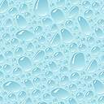
Results and observations
Algorithm | Accuracy
Logistic Regression | 93.6%
Decision Tree Classifier | 92.2%
Support Vector Machine | 96.1%
Random forest | 94.4%

Slide 10
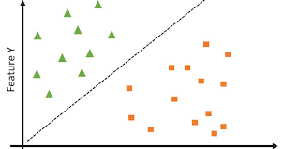
Conclusion
A machine learning classifier for predicting the quality of Indian river water was built successfully in this work with 96.1 percent accuracy, we find that Support Vector Machine(SVM) performs the best when compared to other machine learning models.
Support Vector Machine

Slide 11
References
[1] Zeilhofer, P., Zeilhofer, L. V. A. C., Hardoim, E. L., Lima, Z. M. D., & Oliveira, C. S. (2007). GIS applications for mapping and spatial modeling of urban-use water quality: a case study in District of Cuiabá, Mato Grosso, Brazil. Cadernos de saude publica, 23, 875-884.
[2] Payen, G. (2011). Worldwide needs for safe drinking water are underestimated: billions of people are impacted. Aquafed.
[3] Xiang, Y., & Jiang, L. (2009, January). Water quality prediction using LS-SVM and particle swarm optimization. In 2009 Second International Workshop on Knowledge Discovery and Data Mining (pp. 900-904). IEEE.
[4]Afifah, T., Ahmed, A. N., & El-Shafie, A. (2014). Dissolved oxygen prediction using Support Vector Machine in Terengganu River. Middle East Journal of Scientific Research, 21(11), 2182-2188.
[5]Khan, Y., & See, C. S. (2016, April). Predicting and analyzing water quality using Machine Learning: A comprehensive model. In 2016 IEEE Long Island Systems, Applications and Technology Conference (LISAT) (pp. 1-6). IEEE.

